Slide 1
Tree-Based Models
Exercise 8.4.9
Team 15: Gwen Xu, Mikayla Williams, Ben Silverberg, Stefanie Guizar Diaz

Slide 2
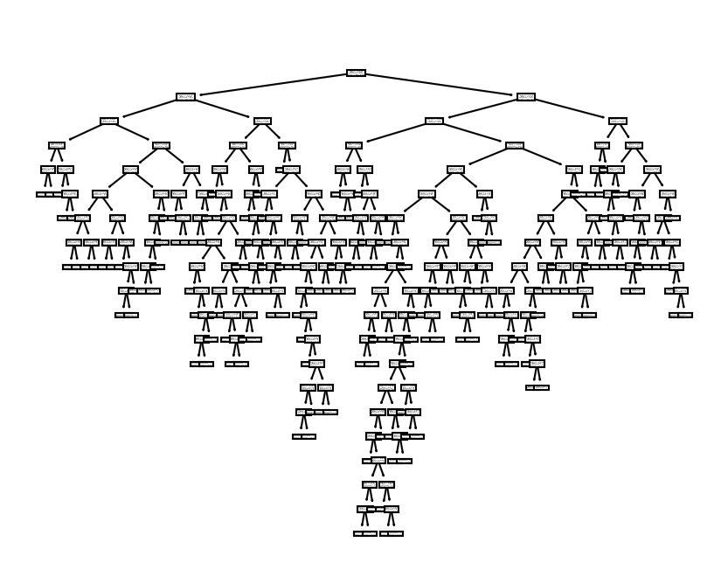
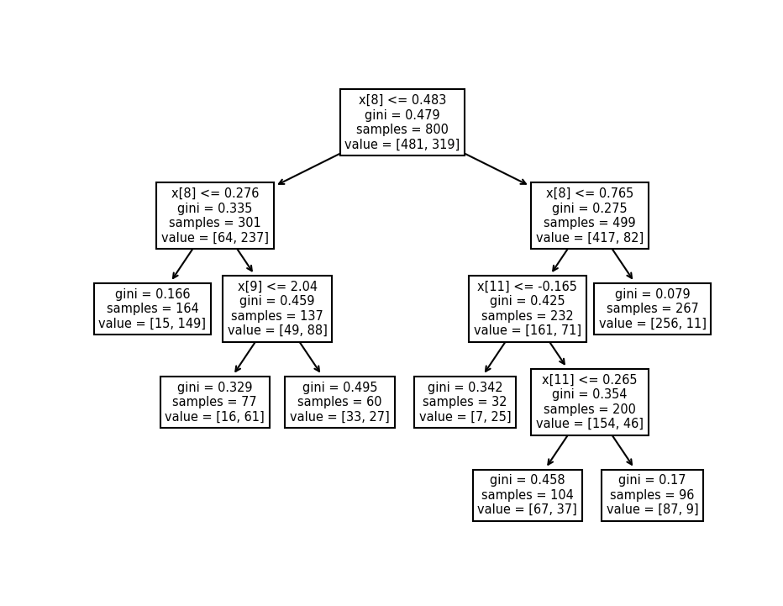
Tree Models (Decision Trees)
- For classification, nodes determine class.
- For regression, answer space broken into regions.
- Large trees subject to “singleton” leaves.
- Large trees overfit!
- Prune trees to trade variance for bias.
- Pruning HUGE trees might actually reduce bias too.

Slide 3
OJ Dataset
Y Target
X Variables
Citrus Hill (CH) or Minute Maid (MM)
Purchases, monitors whether a customer bought CH or MM
1070 observations/purchases
653 CH and 417 MM
18 variables (6 factors)
Week of purchase, Store ID, Price, Discount, etc
Price indicates Minute Maid is more expensive (22 cents)
Notes:
Info on data here: https://rdrr.io/cran/ISLR/man/OJ.html

Slide 4
Exercise 8.4.9
Creating training set using a random sample of 800 observations and creating a test set with the rest.
Fitting a tree to the training data with Purchase as the y target and all other features as predictors.
Predict response on the test data set + create confusion matrix
Apply cv.tree() function to training set to get the best tree size
Produce a pruned tree with the optimal tree size found
Compare train + test error rates
Compare training and testing accuracy on default (overtrained) and pruned trees for our y-target, the purchase of Minute Maid or Citrus Hill

Slide 5


Code Review
vs

Slide 6
Game Time

